Slide 1



Seasonal influenza vaccination in the Americas: update on current policies, use and progress in estimating vaccine effectiveness
Washington DC, febr. 2018
Alba Maria Ropero-Alvarez,
Nathalie El Omeiri,
PAHO/WHO, Washington D.C.
Department of Family, Health Promotion and Life Course, Immunization unit
Red para la Evaluación de Vacunas En Latino América y el Caribe – influenza

Slide 2
Countries and Territories in the Americas
with Policies for seasonal influenza vaccination, 2004-16
Number (%) of countries that have: | 2004 | 2008 | 2016
Policies for influenza vaccination | 13 | 35 | 40/52 (77%)
Vaccination of healthy children Vaccination of children with chronic diseases | 6 | 22 | 25 (48%) 5 (9%)
Vaccination of the elderly | 12 | 33 | 39 (75%)
Vaccination of persons with chronic diseases | 9 | 24 | 35 (67%)
Vaccination of health care workers | 3 | 32 | 38 (73%)
Vaccination of pregnant women | 3 | 7 | 31 (60%)
Notes:
2
2

Slide 3
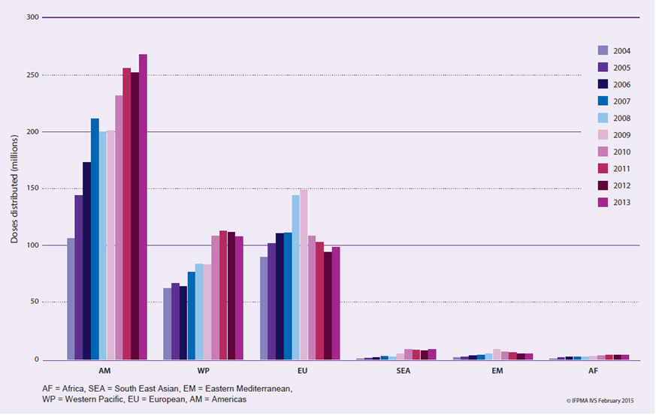

Distribution of influenza vaccines per WHO region, 2004-13
Over 250 M doses distributed annually in the Americas
International Federation of Pharmaceutical Manufacturers (IFPMA)

Slide 4
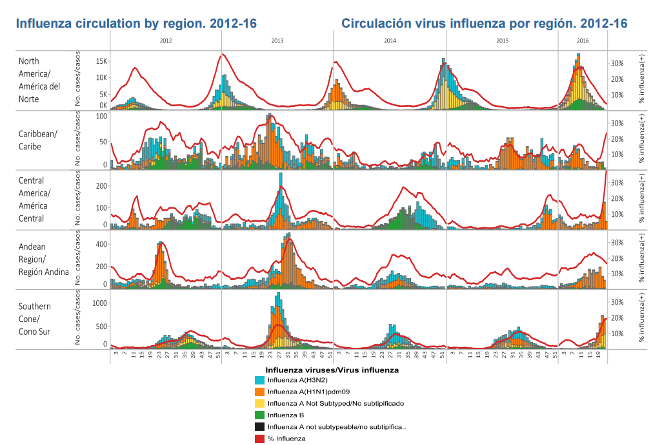

Slide 5
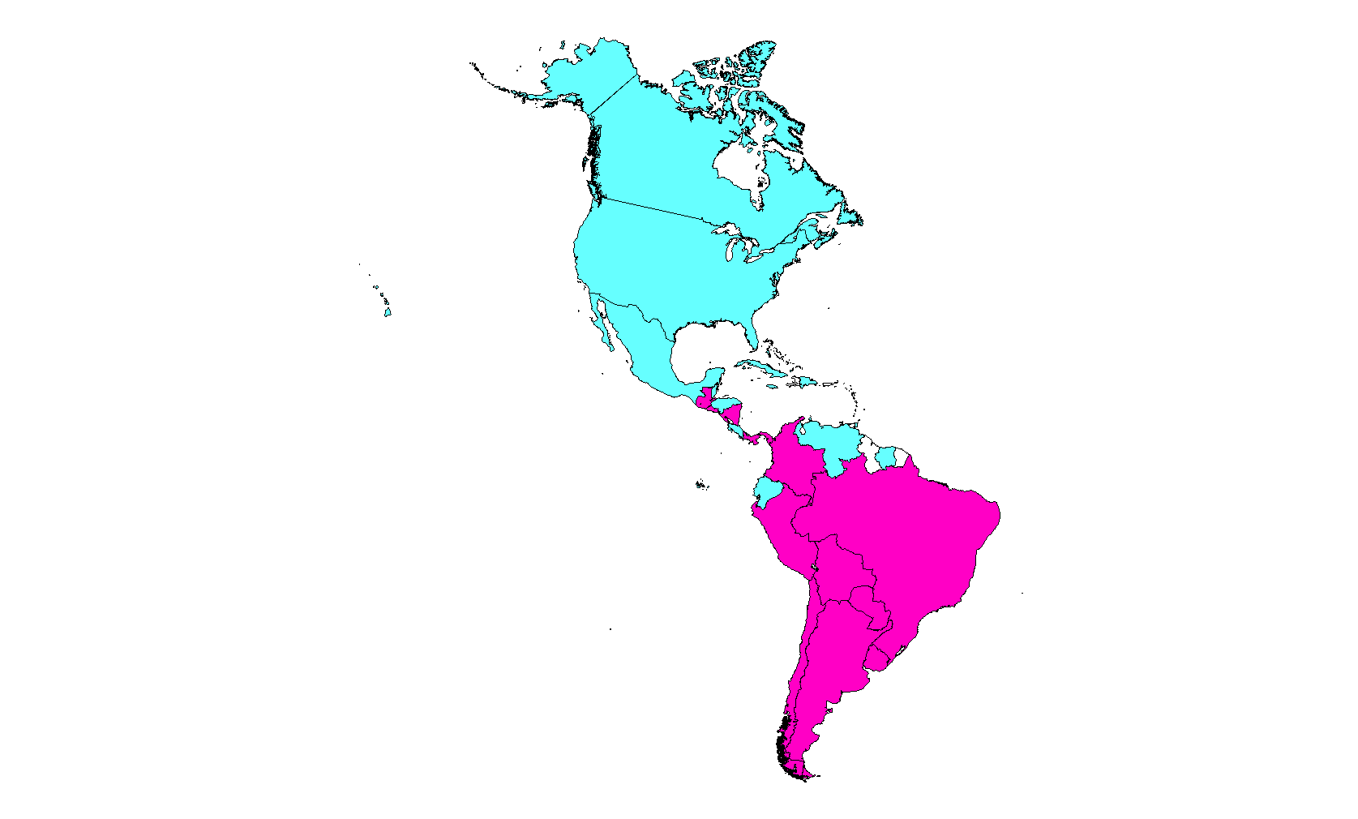
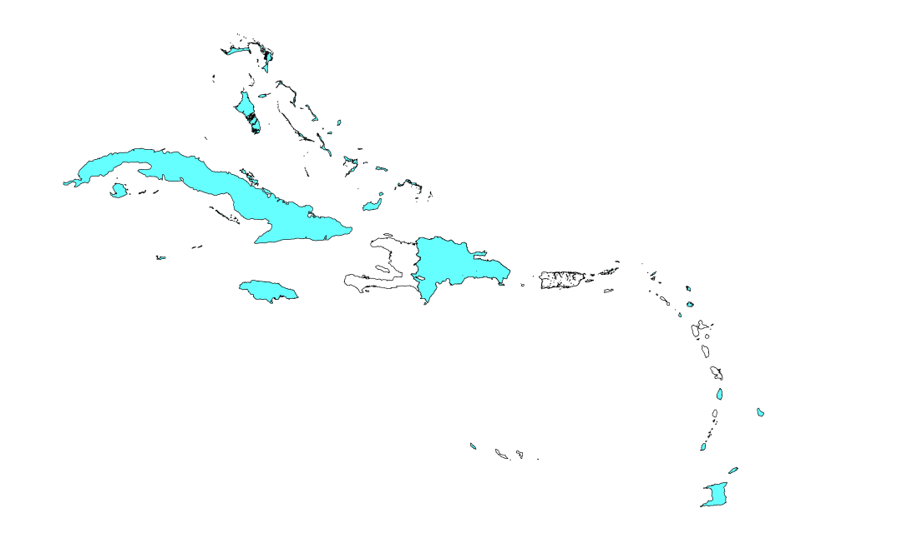
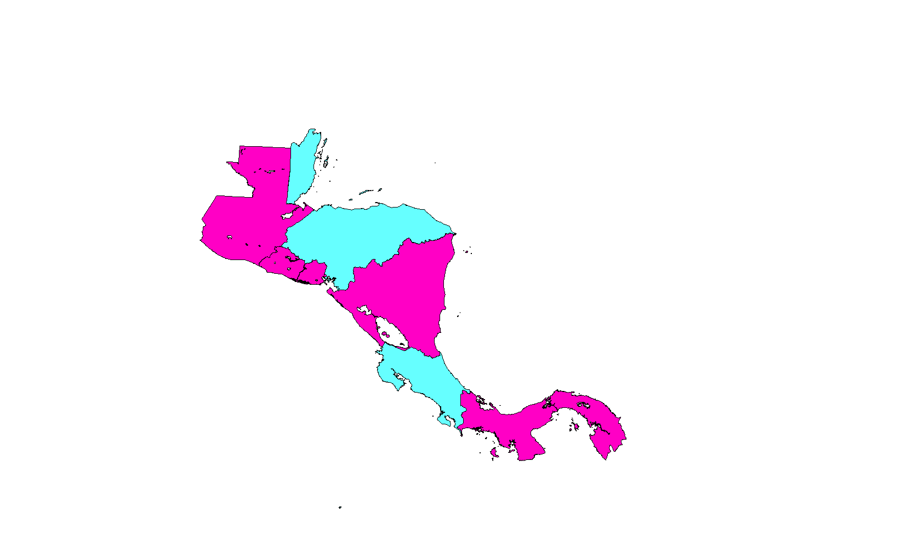
Use of seasonal influenza vaccine
& formulation in the Americas, 2014
Cuba
Bahamas
I. Turcas & Caicos
Jamaica
Haiti
Dominican
Republic
Anguilla
Antigua &
Barbuda
Sta. Lucia
Trinidad & Tobago
Colombia
Venezuela
Northen Hemisphere
Southern Hemisphere
No introduced in the public sector
Belize
Ecuador
Guatemala
Honduras
Brazil
El Salvador
Peru
Nicaragua
Costa Rica
Chile
Paraguay
Panama
Uruguay
Argentina
Source: Country reports to PAHO, MOHs Webpage, PAHO/WHO Surveys
Notes:
In terms of specific influenza vaccine formulation used, as you can see there is consistent use either N or S vaccine formulation in temperate areas with mix use in tropical areas
The question of which is the best formulation to use in the tropics is a complex one but the key is strengthening surveillance

Slide 6
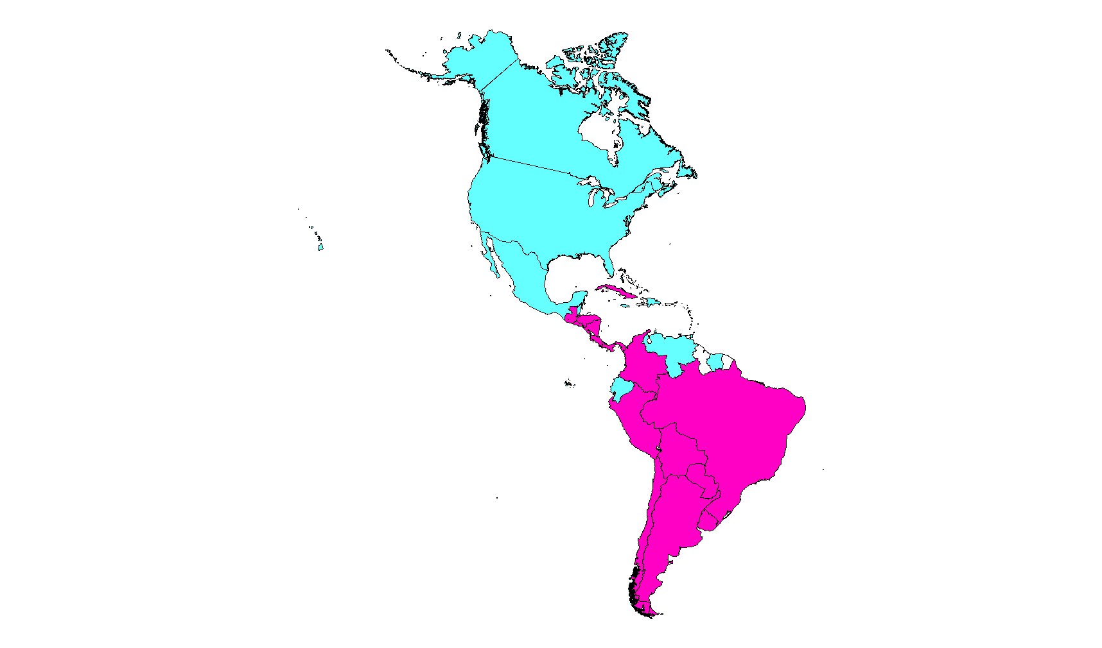
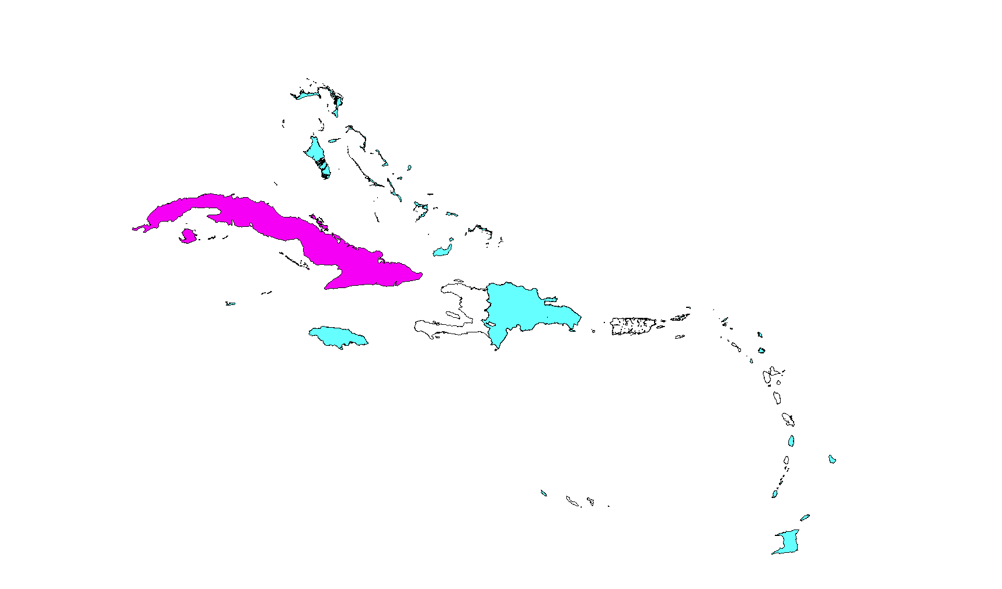
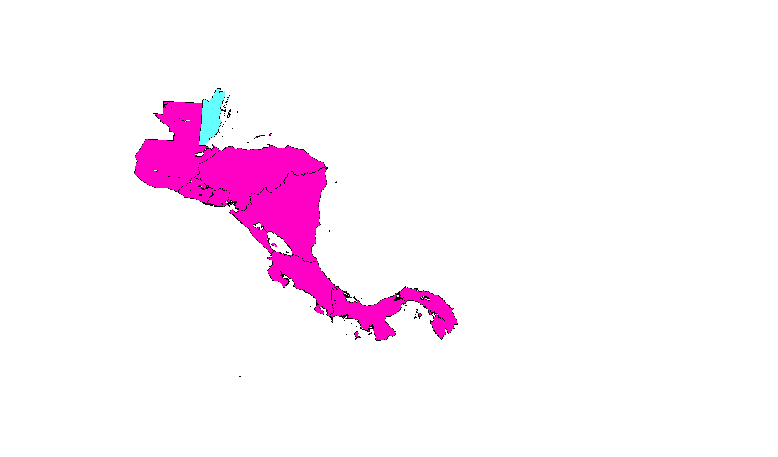
Use and formulation of seasonal influenza vaccines
in the Americas, 2015
Cuba
Bahamas
I. Turcas & Caicos
Jamaica
Haiti
Dominican
Republic
Anguilla
Antigua &
Barbuda
Sta. Lucia
Trinidad & Tobago
Colombia
Venezuela
Northern Hemisphere
Southern Hemisphere
Not introduced in the public sector
Belize
Ecuador
Guatemala
Honduras
Brazil
El Salvador
Peru
Nicaragua
Policy change from NH to SH vaccine
Colombia (2007)
El Salvador (2011)
Guatemala (2012)
Cuba (2015)
Honduras (2015)
Costa Rica (2015)
Costa Rica
Chile
Paraguay
Panama
Uruguay
Argentina
Source: Country reports to PAHO, MOHs Webpage, PAHO/WHO Surveys

Slide 7
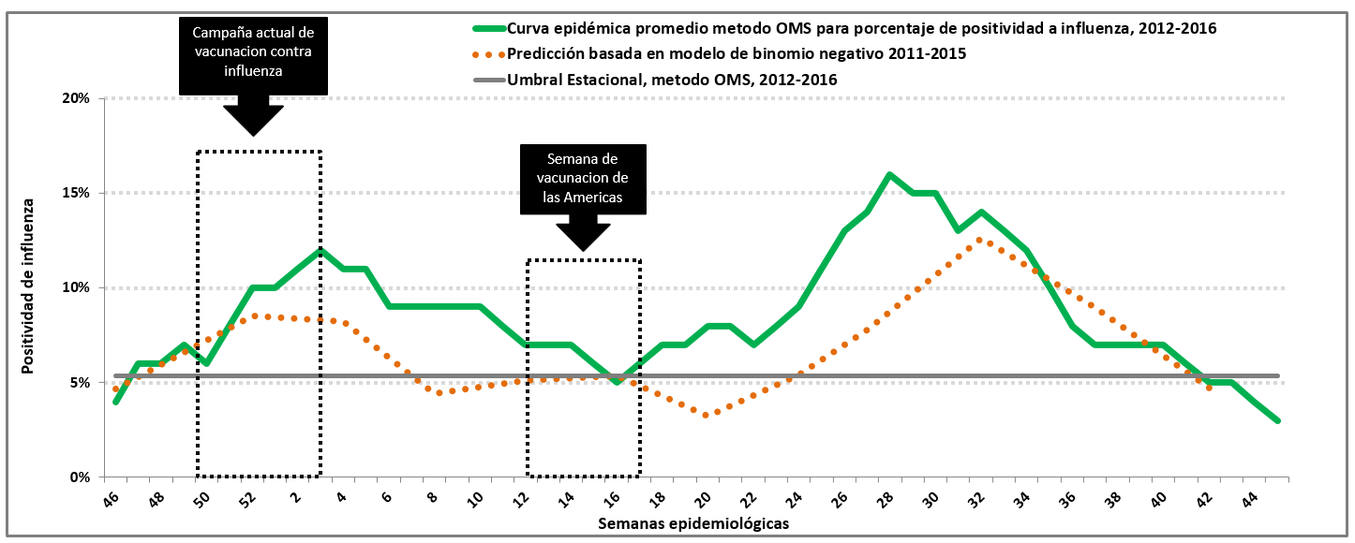
Seasonality of influenza and vaccination, Ecuador 2011-16 (n=2,075)
Fuente: Ecuador. Vigilancia centinela de IRAG, datos virológicos reportados a FluNet 2011-2016.
Notes:
El Ecuador cuenta actualmente con datos de vigilancia de calidad de cinco años tal y como lo recomienda la OMS para la caracterización de la estacionalidad de la OMS.
El análisis de los datos (Grafica) estableció el umbral estacional obtenido para el periodo 2012-2016 en un 5% de positividad a influenza (usando todas las pruebas). Se registró circulación de virus de influenza durante todo el año, y coincidentemente con dos metodologías se identificó que la curva epidémica de influenza presentaba dos periodos de actividad marcados. El primer pico entre finales de diciembre y mediados de febrero y el segundo pico, entre mediados de junio y finales de agosto.
La amplitud de la estación de influenza es similar entre los dos periodos, con duración entre 15 y 16 semanas epidemiológicas (SE). Se observa que el segundo pico es mayor y que durante el segundo periodo de actividad se concentra más del 60% de los casos IRAG positivos a influenza de los últimos 5 años.
Teniendo en cuenta este análisis, y la concentración de la mayor carga de influenza entre junio y agosto, es importante considerar la oportunidad de la vacunación definiendo el mejor momento para prevenir la mayor carga de enfermedad asociada a influenza. En ese caso, la vacuna disponible más actualizada seria la del hemisferio sur. La vacunación durante abril-mayo permitiría alcanzar altas coberturas antes del inicio de la temporada y de la ocurrencia del mayor pico epidémico. Además garantizaría para los vacunados que se cumpla con el periodo de las dos semanas necesarias para desarrollar inmunidad.

Slide 8
Influenza vaccine coverage among the elderly Latin America and the Caribbean, 2015 and 2016*
Source: Country reports through the PAHO-WHO Joint Reporting Forms (JRF), 2016 and 2017.
* Provisional data

Slide 9
Influenza vaccine coverage among children less than 5 years old Latin America and the Caribbean, 2015-2016* (full vaccination only)
Source: Country reports through the PAHO-WHO Joint Reporting Forms (JRF), 2016 and 2017.
Note Pediatric coverage formula: ((2nd dose+single dose)/denominator)*100
* Provisional data

Slide 10
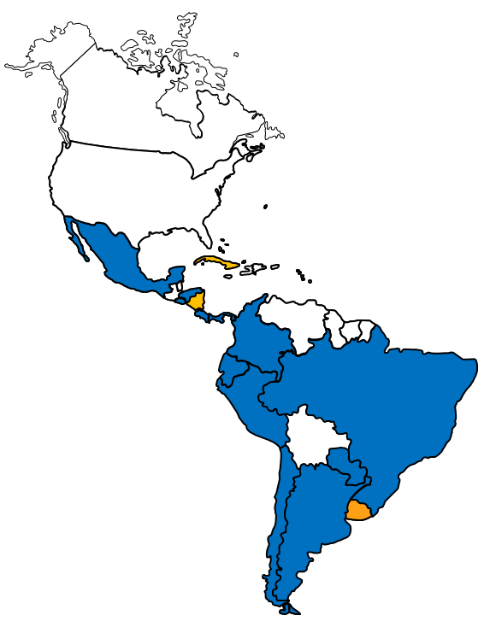

REVELAC-i network evolution (Red para la Evaluación de Vacunas de Influenza en América Latina y el Caribe)
Multicenter case-control study: to estimate VE against PCR-confirmed influenza-associated SARI among vaccination target groups during the influenza season
15 REVELAC-i members
Multicenter VE case-control study
Members of the network
2013 Implementation
& network launch
(9 SH + 1 NH)
2012
Pilot phase
(4 SH)
2014
(7 SH + pilot in Ecuador)
2016
Uruguay
Costa Rica
El Salvador
Honduras
Panama
+ Argentina
Brazil
Chile Colombia
Paraguay
+ México
2015
(5 SH+ pilot in Peru)

Slide 11


Network for Evaluation of Influenza Vaccine Effectiveness in Latin America and the Caribbean REVELAC-i
Objectives:
Estimate the effectiveness of influenza TIV in preventing severe acute respiratory infections (SARI) laboratory-confirmed for influenza among EPI target groups during influenza seasons.
Building upon the existing regional SARI surveillance platform.
Using a common protocol, case-control (test-negative design).
RT-PCR laboratory confirmation for influenza.
Multidisciplinary efforts integrating influenza surveillance teams, refence laboratories and immunization programs
Revelac-i

Slide 12
Use of VE estimates in LAC
Differences in use of VE between developed and developing countries
EPI provides vaccine free of charge and need to sustain investment in the vaccine (flu vaccine first target of budget cuts).
Show benefit of vaccination with current strategies as averted deaths and hospitalizations
Not yet information for action, although REVELAC-i contributes to GIVE

Slide 13
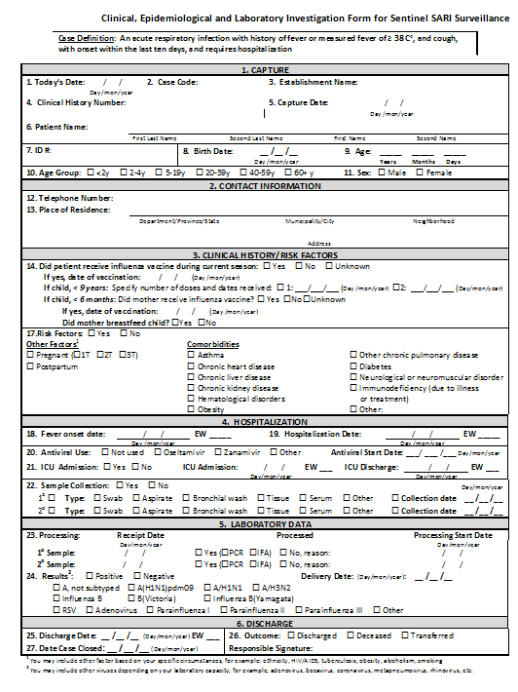

Slide 14
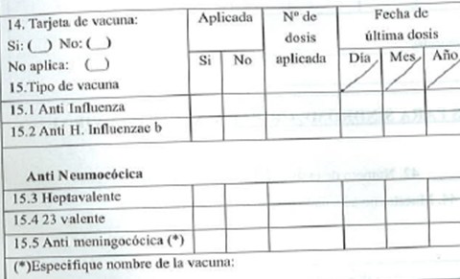
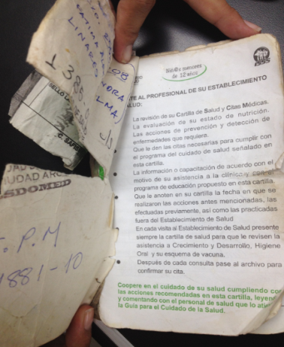
Vaccination status ascertainment
SARI surveillance forms/databases
1. Improve completeness at hospital level and collect additional variables if necessary (ex.doses)
2. Complete vaccination data a posteriori
Matching patients by ID, name, age, address
Electronic national nominal vaccination registry
EPI records at local level (nominal in paper, or Excel, vaccination cards reviewed through household visits/calls
Chile, Costa-Rica, Uruguay,
Colombia and partly in Panama
Other countries

Slide 15
Study population
Country | Vaccination Target groups |  |  | N SARI hospitals
 | Children | Elderly | Individuals with chronic conditions
Argentina | 6–24 months | ≥65 years |  | 4
Brazil | 6–23 months | ≥60 years |  | 29
Chile | 6–23 months | ≥65 years | X | 6*
Colombia | 6–23 months | ≥60 years |  | 7
Costa Rica | 6 months–10 years with chronic cond. | ≥65 years |  | 6*
Cuba | 6–23 months | ≥65 years |  | TBD
El Salvador | 6–59 months | ≥60 years |  | 4*
Ecuador | 6–59 months | ≥50 years | X | 3
Honduras | 6–35 months with chronic cond. | ≥60 years |  | 3*
México | 6–59 months; 3–9 years with chronic cond. | ≥65 years | X | 46
Panamá | 6–59 months | ≥60 years |  | 10*
Paraguay | 6–35 months | ≥60 years |  | 2
Peru | 6–24 months | ≥60 years |  | 3
Uruguay | 6–48 months | ≥65 years |  | 7*
TOTAL | 6–59 months | ≥60 years |  | 130
*All SARI surveillance sentinel hospitals included

Slide 16
Influenza cases and controls included in regional VE analysis, REVELAC-i
2013
 | Argentina | Brazil | Chile | Colombia | Costa-Rica | Honduras | Panama | Paraguay | El Salvador | Total
Influenza | 36 | 277 | 133 | 69 | 71 | 6 | 20 | 75 | 7 | 694
(%) | 5 | 40 | 19 | 10 | 10 | 0.9 | 3 | 11 | 1 | 100
Controles | 54 | 728 | 616 | 165 | 79 | 3 | 49 | 222 | 10 | 1,926
(%) | 2.8 | 37.8 | 31.98 | 8.57 | 4.1 | 0.16 | 2.54 | 11.53 | 0.52 | 100
Total | 90 | 1,005 | 749 | 234 | 150 | 9 | 69 | 297 | 17 | 2,620
(%) | 3 | 38 | 29 | 9 | 6 | 0.3 | 3 | 11 | 0.7 | 100
2014
 | Argentina | Brazil | Chile | Colombia | Honduras | Paraguay | El Salvador | Total
Influenza | 16 | 145 | 194 | 24 | 8 | 43 | 4 | 434
(%) | 4 | 33 | 45 | 6 | 2 | 10 | 0.9 | 100
Controles | 54 | 413 | 1,027 | 97 | 20 | 128 | 12 | 1,751
(%) | 3 | 24 | 59 | 6 | 1 | 7 | 0.7 | 100
Total | 70 | 558 | 1,221 | 121 | 28 | 171 | 16 | 2,185
(%) | 3 | 26 | 56 | 6 | 1 | 8 | 0.7 | 100
2017: 2851 SARI patients, 587 flu(+) (ARG, CHI, PAR)
2015
2016
 | Chile | Colombia | Paraguay | Peru | Total
Influenza | 394 | 33 | 76 | 17 | 520
(%) | 75.8 | 6.3 | 14.6 | 3.3 | 100
Controles | 1,705 | 90 | 222 | 149 | 2,166
(%) | 79 | 4 | 10 | 7 | 100
Total | 2,099 | 123 | 298 | 166 | 2,686
(%) | 78 | 5 | 11 | 6 | 100
 | Argentina | Chile | Colombia | Paraguay | Uruguay | Total
Influenza | 37 | 226 | 11 | 77 | 67 | 418
(%) | 8.9 | 54.1 | 2.6 | 18.4 | 16.0 | 100
Controles | 209 | 1,048 | 93 | 224 |  | 1,574
(%) | 13 | 67 | 6 | 14 | 0 | 100
Total | 246 | 1,274 | 104 | 301 | 67 | 1,992
(%) | 12 | 64 | 5 | 15 | 3 | 100

Slide 17
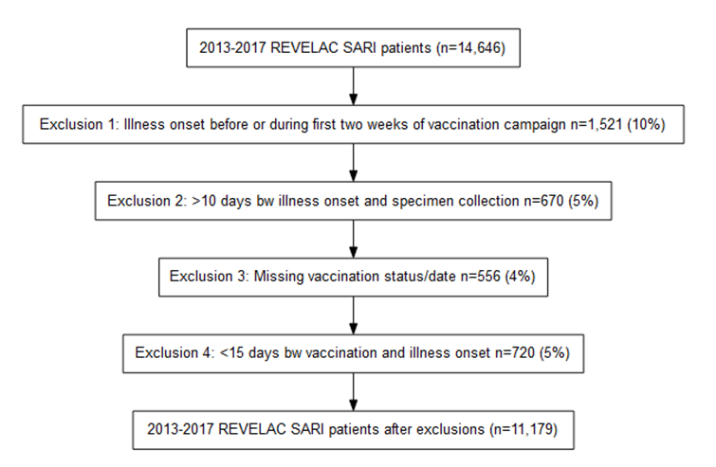
REVELAC-I 2013-2017

Slide 18
REVELAC-I 2013-2017
Variable | Cases n=2,409 n(%) | Controls n=8,770 n(%) | p-value
Country
Argentina | 166 (7) | 627 (7) | <0.001
Brazil | 421 (17) | 1148 (13)
Chile | 1300 (54) | 5401 (62)
Colombia | 152 (6) | 390 (4)
Paraguay | 328 (14) | 954 (11)
Uruguay | 42 (2) | 250 (3)
Year
2013 | 583 (24) | 1855 (21) | <0.001
2014 | 415 (17) | 1687 (19)
2015 | 521 (22) | 1995 (23)
2016 | 397 (16) | 1644 (19)
2017 | 493 (20) | 1589 (18)
Gender
Male | 1116 (46) | 4375 (50) | 0.002
Female | 1293 (54) | 4395 (50)
Age group
0-18 years | 679 (28) | 3338 (38) | <0.001
19-64 | 399 (17) | 1224 (14)
65+ | 1331 (56) | 4208 (48)

Slide 19
REVELAC-I 2013-2017
Variable | Cases n=2,409 n(%) | Controls n=8,770 n(%) | p-value
≥one chronic condition | 1573 (65) | 5518 (63) | <0.001
Asthma | 197 (8) | 732 (8) | 0.25
Diabetes | 416 (17) | 1176 (13) | <0.001
Respiratory disease | 407 (16) | 1595 (18) | 0.31
Cardiovascular disease | 323 (13) | 1037 (12) | 0.006
Liver disease | 37 (2) | 126 (1) | 0.91
Renal disease | 164 (7) | 536 (6) | 0.37
Obesity | 113 (5) | 323 (4) | 0.05
Immune disease | 94 (4) | 479 (5) | 0.001
Seasonal vaccination | 897 (37) | 4220 (48) | <0.001
Admitted to ICU | 424 (18) | 1433 (16) | 0.02
Deceased | 220 (9) | 625 (7) | 0.004
Days from illness onset to specimen collection
0 to 2 | 576 (24) | 2633 (30) | <0.001
3 to 5 | 57 (2) | 393 (4)
6 to 10 | 1776 (74) | 5744 (65)

Slide 20
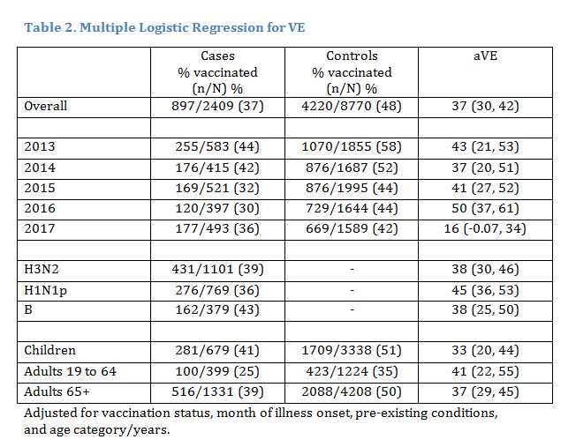
REVELAC Flu VE estimates 2013-2017

Slide 21
Distribution of cases, controls per week of symptoms onset and vaccinees per week of vaccination, in 9 LAC countries, 2013
SH End-of-season VE
SH Interim VE

Slide 22
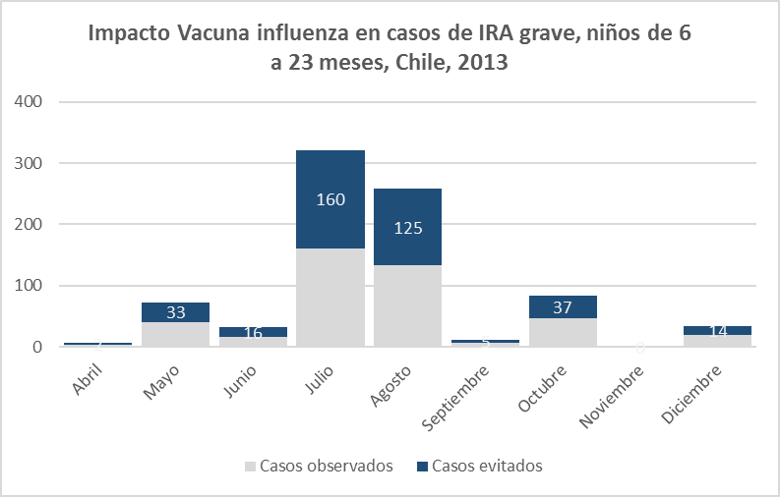
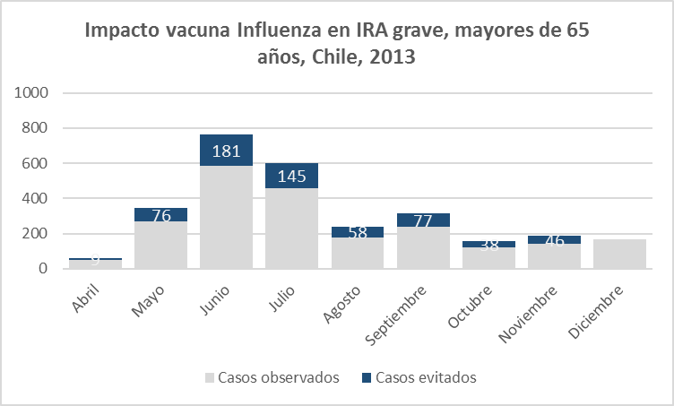
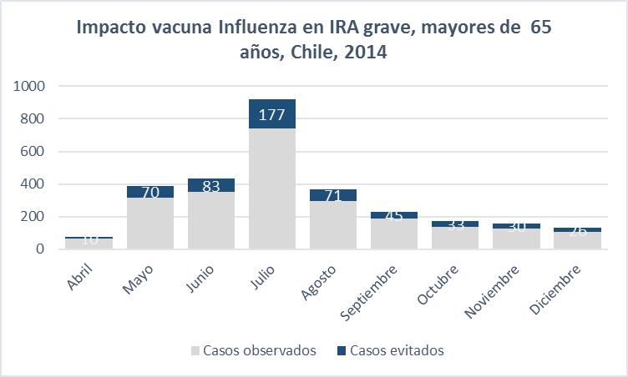
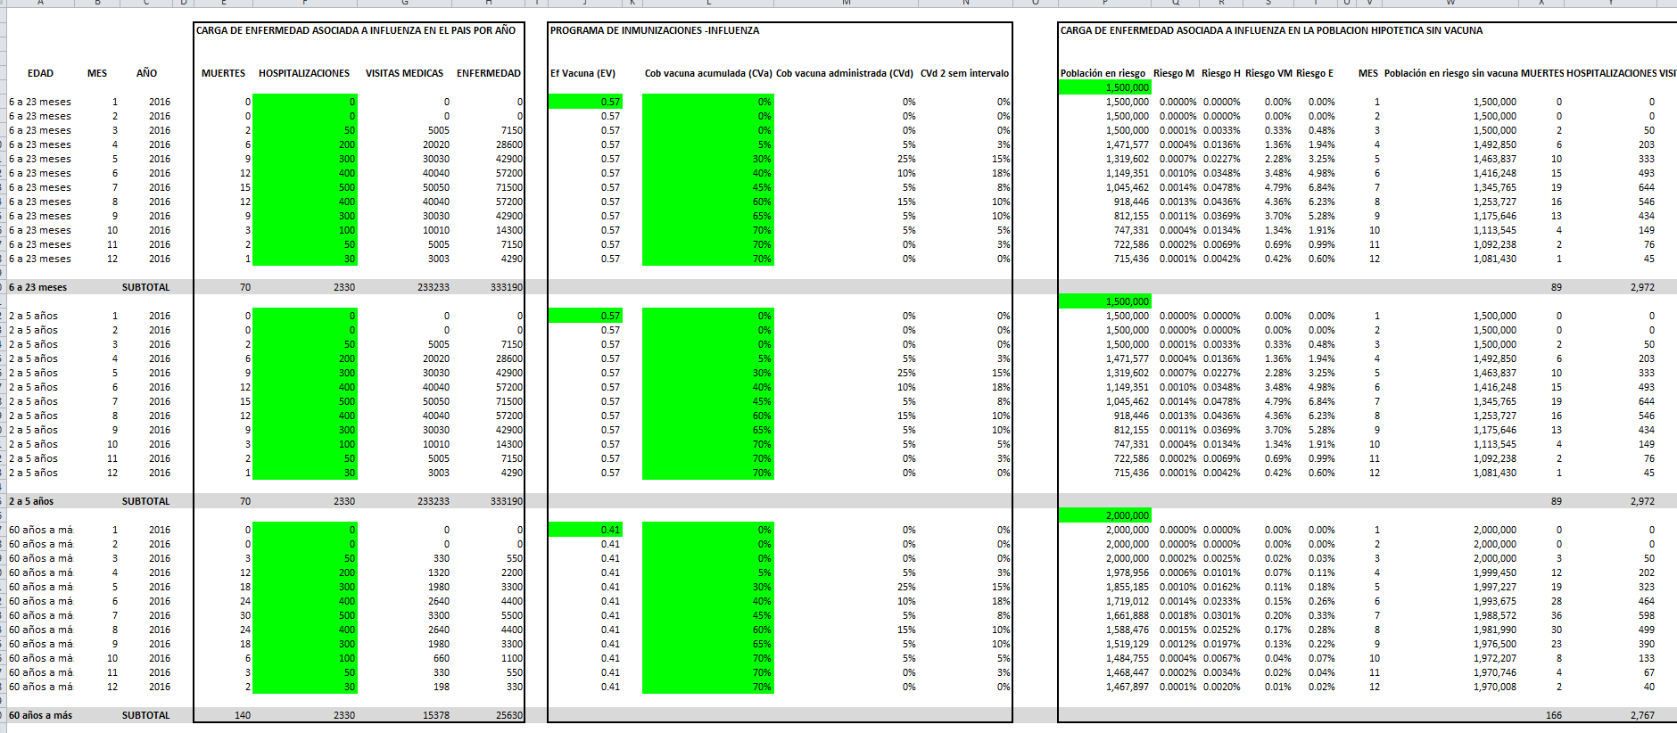
Influenza Vaccine Impact
Number of averted SARI hospitalizations by vaccination
among children <5 years and the elderly, Chile 2013-14
2013
2014

Slide 23
Challenges for REVELAC-i
Sustainability of the platform
High turnover of surveillance and EPI staff,
Uses existing surveillance platform (no additional resources for staff or research groups)
Information systems/integration
Political changes
Vaccination status retrieval and timeliness of interim VE estimates
Sample size
Translation of evidence for decision makers

Slide 24
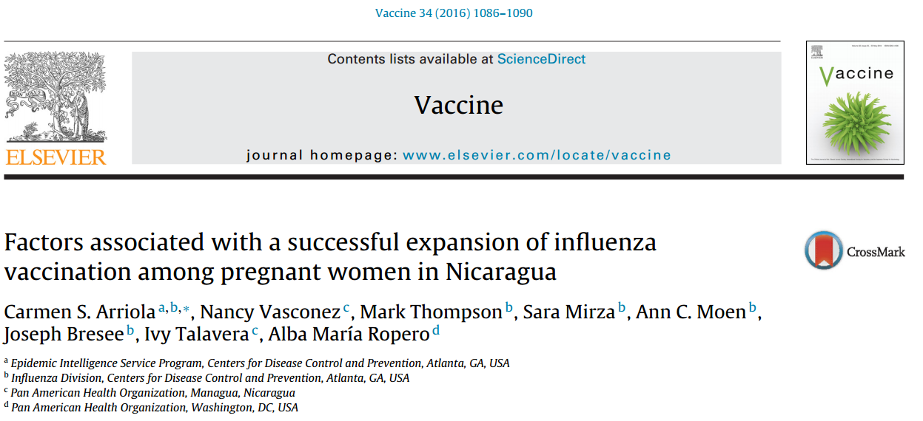
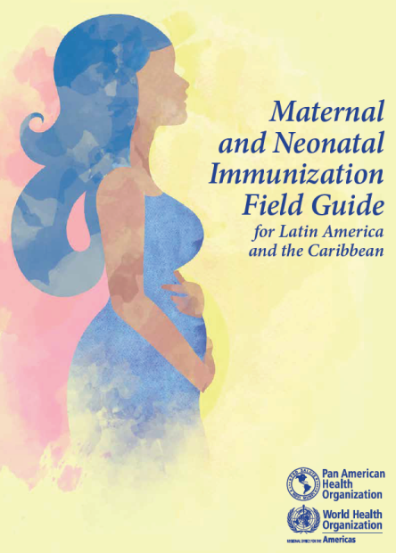
31/35 countries that vaccinate pregnant women against influenza are located in the Americas
In 2013, Nicaragua expanded recommendations to include influenza vaccination to all pregnant women in Managua:
Survey among 1,807 pregnant women who delivered at public hospitals in Managua to evaluate the uptake of influenza vaccination and factors associated with vaccination.
Four antenatal visits were associated with receipt of influenza vaccination (OR=2.6 [1.15; 5.81]).
Receipt of influenza vaccination recommendation from a health care provider was positively associated with receipt of influenza vaccination (OR=14 [10; 19]).
Technical guidelines for Maternal and neonatal immunization:
Vaccination recommendations
Available vaccines
Current evidence
Operational aspects
Communication
Best practices

Slide 25
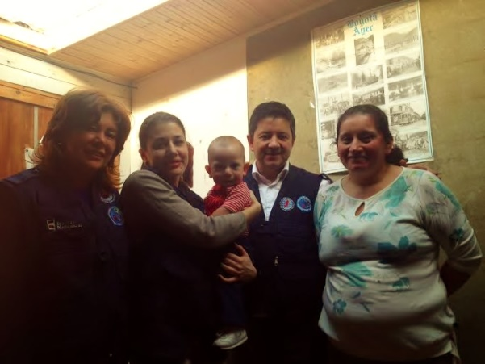
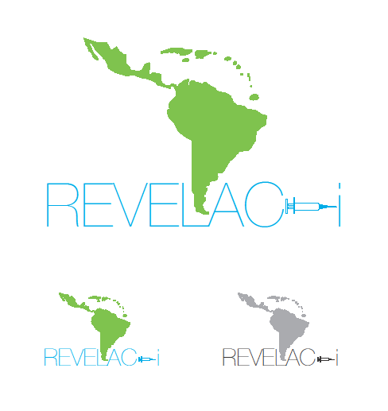
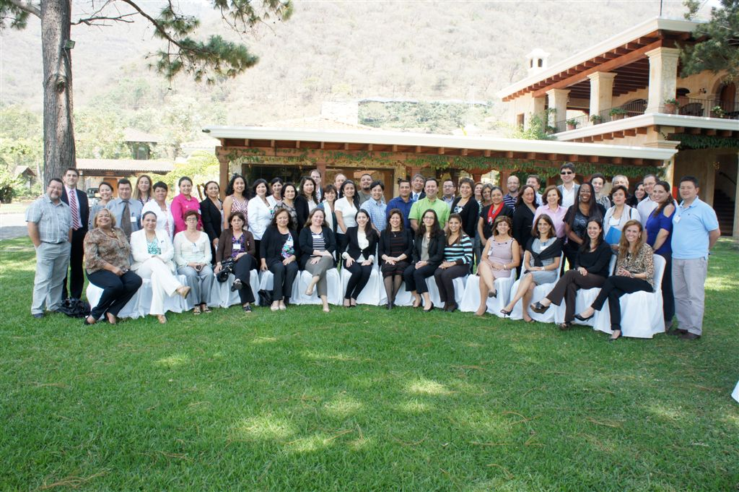
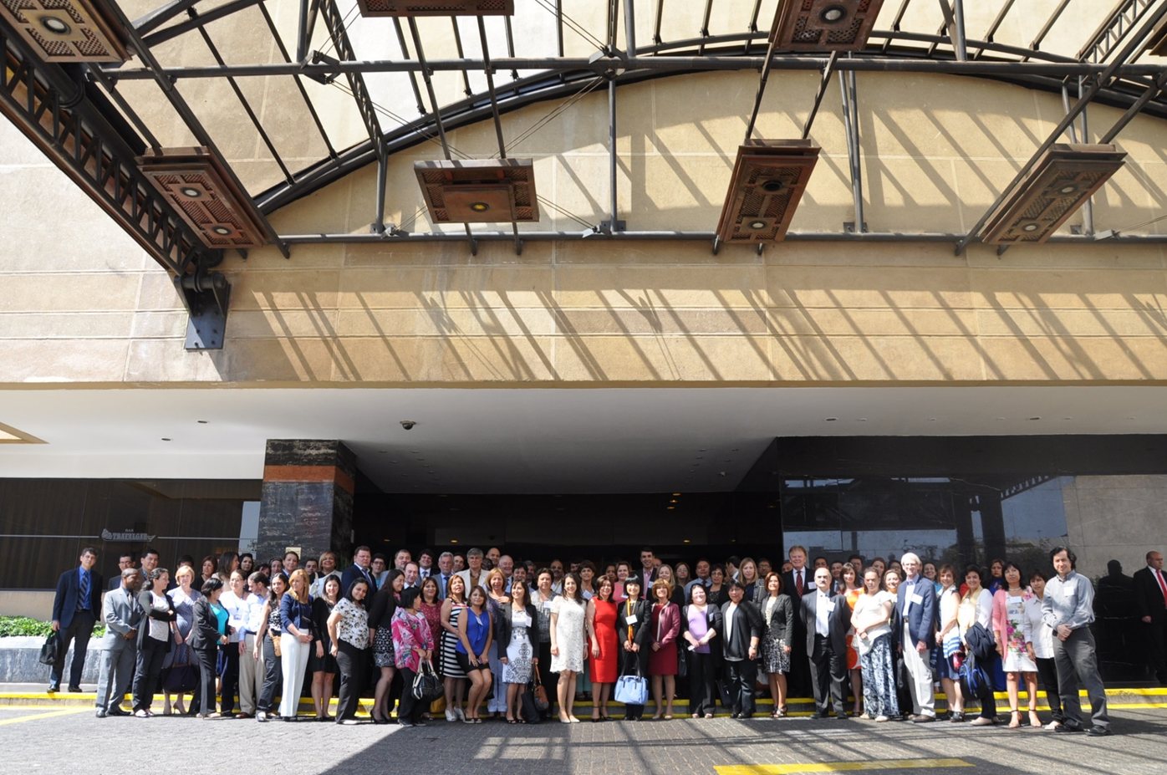
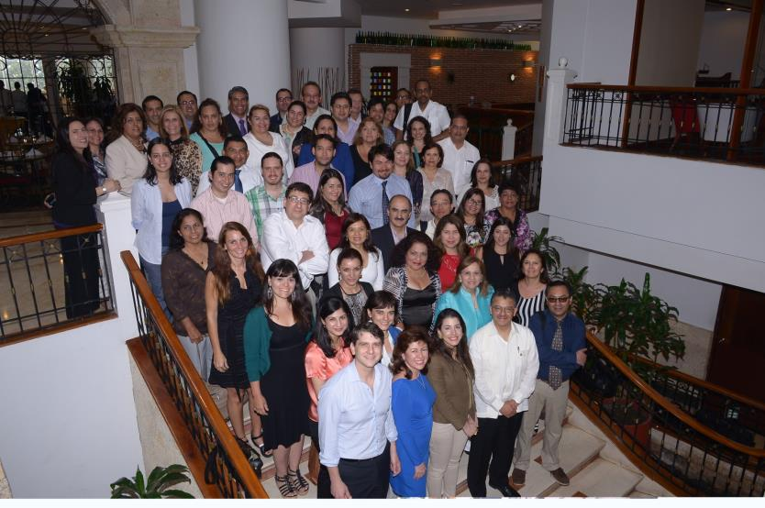
1st network meeting La Antigua Guatemala, 2013
2nd network meeting,
Cartagena de Indias, 2014
Antigua - Guatemala. 27 February 2013
3rd network meeting,
Santiago de Chile, March 2016
GRACIAS!
http://www.paho.org/revelac-i/

